Slide 1
COGS 138: Week 3 Section
January 19th, 2021

Slide 2
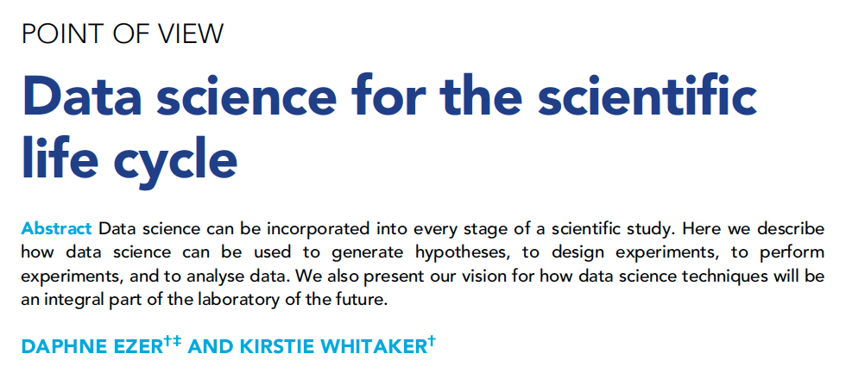
Questions about Reading #1?

Slide 3
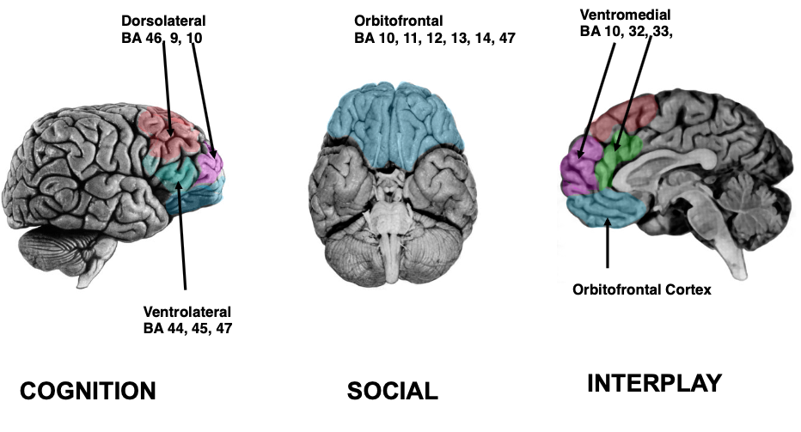
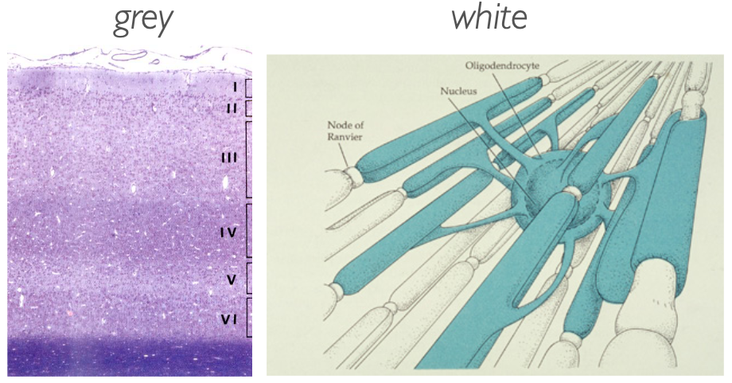
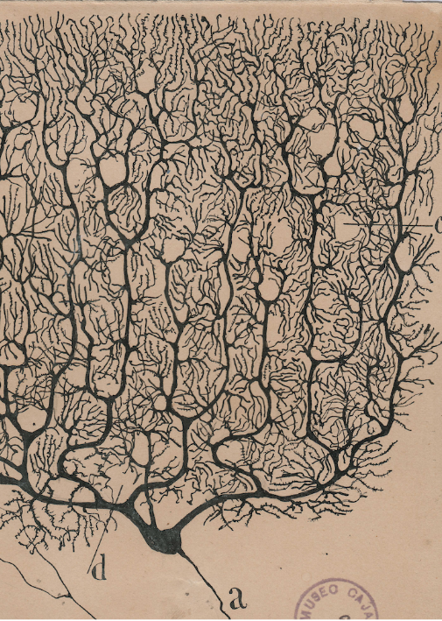
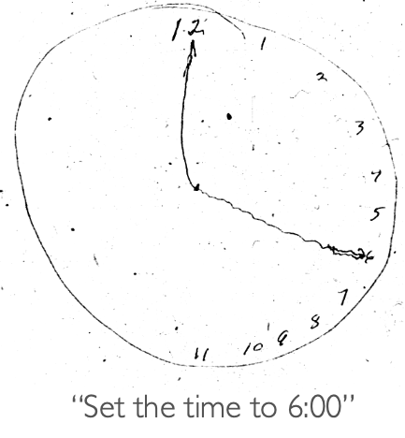
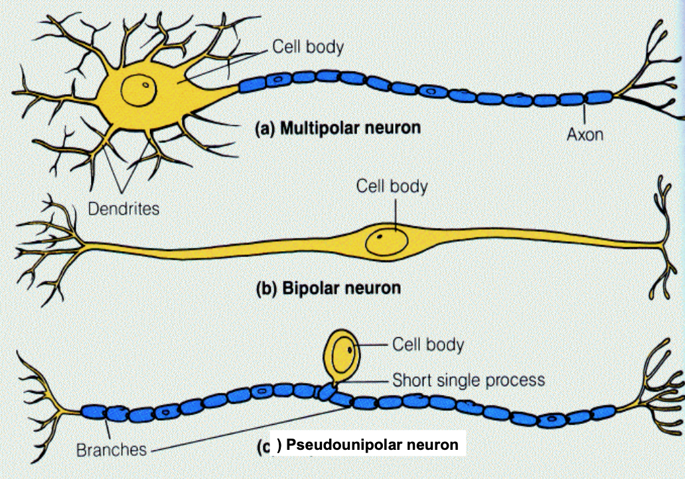
Neuroanatomy Lecture:
There is STRUCTURE and REGULARITY within the brain.
Which means you can use data science to PREDICT aspects about neural data.
Notes:
We went over SO MUCH about the brain and it’s parts, it’s functions, neuron types, how that maps to behavior, and disease, etc.
From all this neuroscience research, we know that the brain inherently has a structure, and it regularly maps to specific behaviors or disorders, etc.
THEREFORE, the reason this is a useful model for this class is because the brain is then by definition a potentially predictable entity. We can use the toolbox of data science and apply it to neural data in order to understand more about the brain.

Slide 4
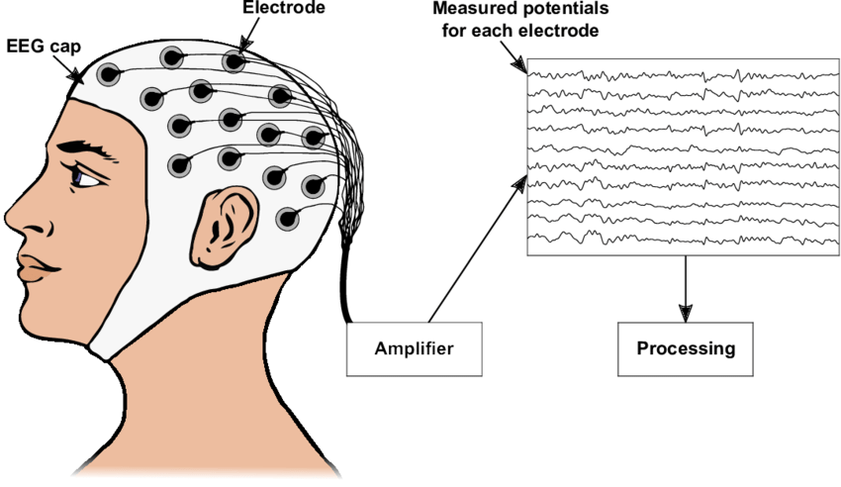
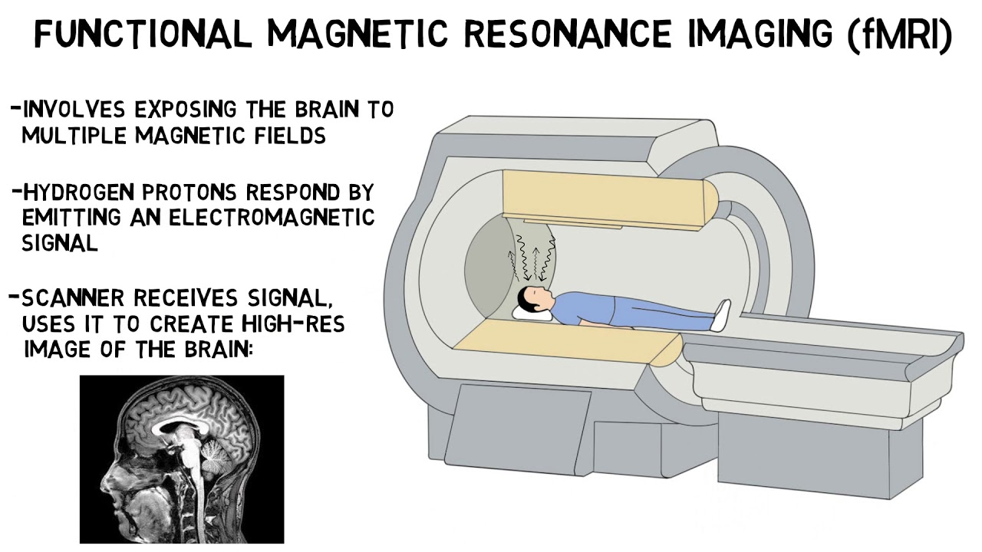
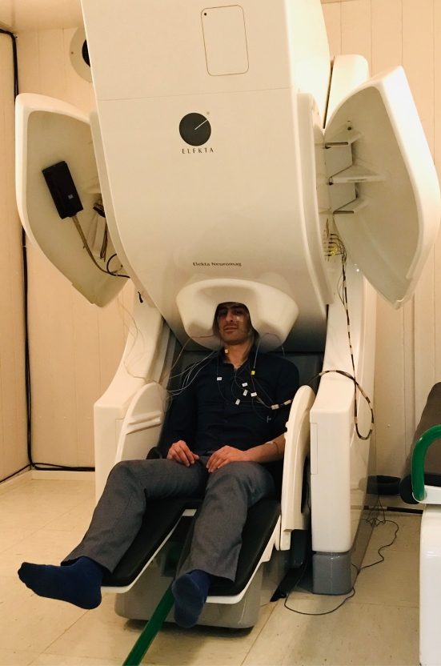
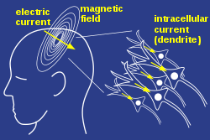
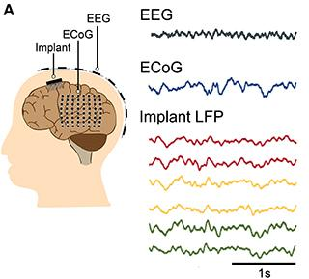
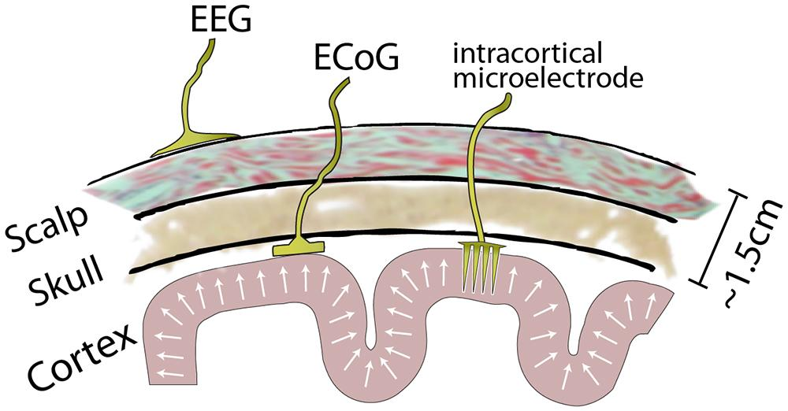
What is neural data?
Notes:
fMRI: indirect measure of brain activity via BOLD signal
Neurons need oxygen to fire
Haemodynamic response = blood releases oxygen to active neurons more than inactive neurons
fMRI detects the change in relative levels of oxygenated vs. deoxygenated blood based on the different magnetic susceptibility
MEG: slightly more direct measure of brain activity via magnetic fields produced by electrical currents
The net effects of ionic currents from neurons during synaptic transmission
EEG/ECoG/Implanted electrodes: direct measure of electrical brain activity
The currency of neurons is electricity and this neural data measures electrical activity
It gets complicated because you don’t know exactly what the electrical activity is measuring from
Buzsaki, 2012 paper
https://www.ncbi.nlm.nih.gov/pmc/articles/PMC4907333/

Slide 5
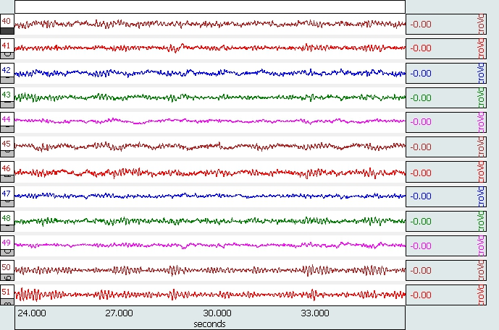
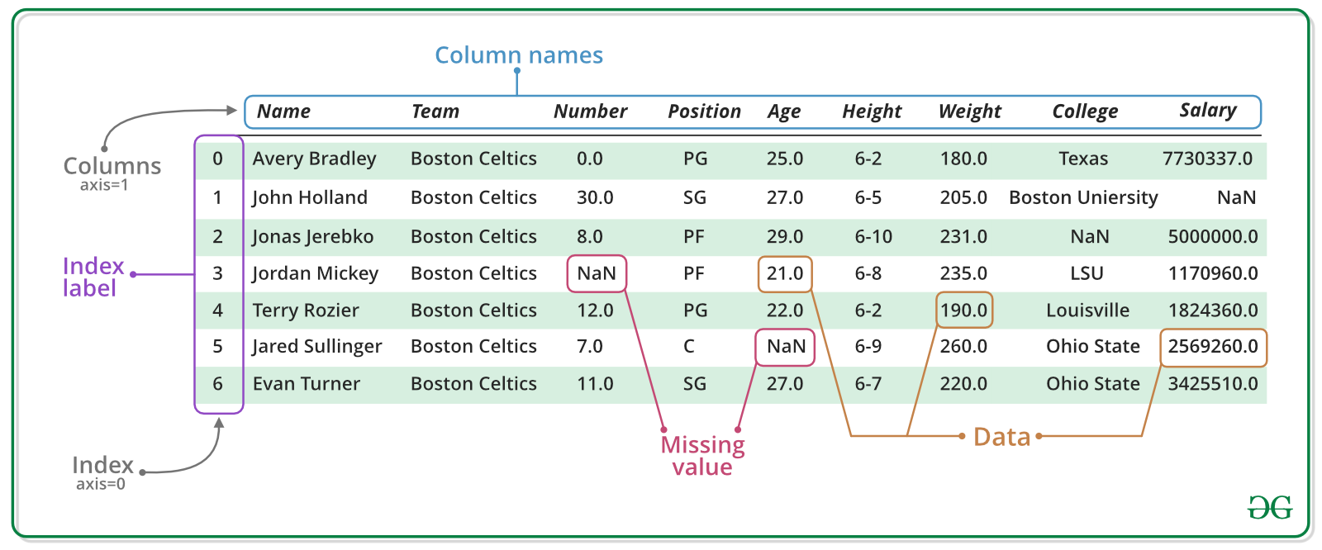
Each dataset is inherently unique
In this class, you should be asking yourself:
How can we best turn these data into numbers that can be analyzed?
Notes:
Each of these datasets will look different based on the fact that they are measuring different things. But also within the same tool, context matters. Each dataset will have been collected in specific conditions.
ECoG data is at a hospital, EEG data is probably at a university with students, etc.
Prof. Voytek’s main goal as a neuroscientist so far has been to TURN THESE DATA INTO NUMBERS THAT CAN BE ANALYZED.
And this is not a simple thing to do

Slide 6
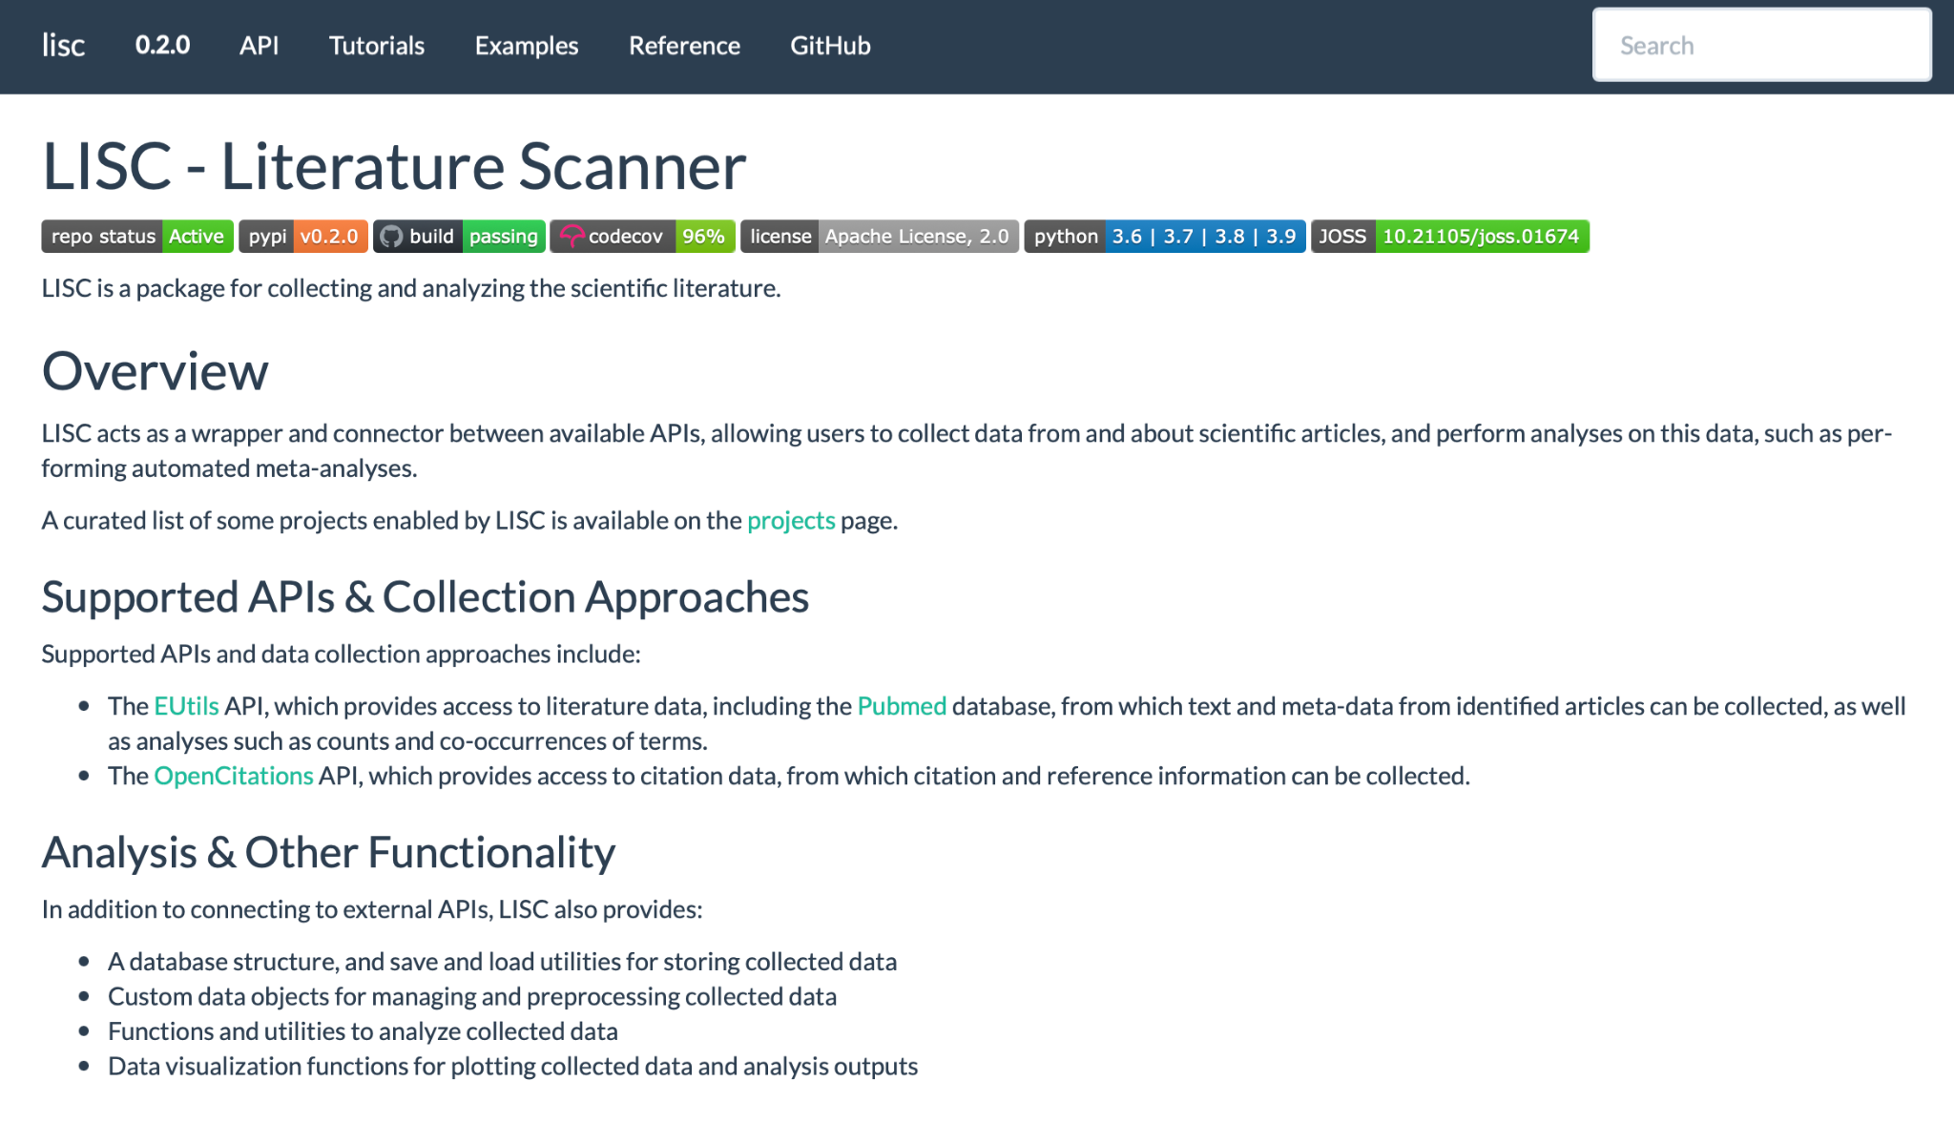
Brief Overview of A2 (released on datahub tomorrow)
LISC (LIterature SCanner): a package for collecting and analyzing the scientific literature
You will be:
Making your own search for keywords
Using methods in LISC to compare keywords, areas of the brain, etc.
https://lisc-tools.github.io/lisc/index.html
Notes:
A direct implementation of using data science tools, like text mining, in the scientific method (to accomplish hypothesis generation/general exploration).

Slide 7
Project brainstorming

Slide 8
Attention
Motor brain regions
Brain organoids
(little brains in a dish)
EMOTION
Emotion and how it relates to memory
Sports and the brain
Depression
MUSIC
Neural decoding
(reconstructing images from brain scans)
Meditation
Concept association + physiological signals
Brain Computer Interface (BCI)
Cancer
DSM-5 and Neuroimaging
Transcranial Magnetic Stimulation (TMS)
Neurodivergent classification
Autism
ADHD
Continue text mining project from last year
Sleep and cognitive function

Slide 9
General Announcements and Reminders
Reading Quiz due this Friday (1/21/22) at 11:59 PM (PST)
Three attempts
We will grade your last attempt, not your best attempt
A2 due next Friday (1/28/22) at 11:59 PM (PST)
A2 will be released TOMORROW (1/20/22)

